Slide 1
Sistem Pengaturan Formasi dan Kolaborasi
EE185523
Graph theory and algebraic graph theory
Yurid Eka Nugraha
TSP DTE FTEIC ITS

Slide 2
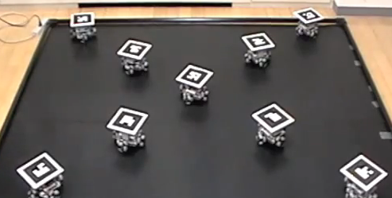


Graph?
(digi.com)
EE185523 2022E – 1

Slide 3
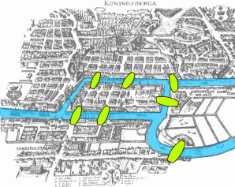
Euler & Königsberg bridge (1736)
EE185523 2022E – 1

Slide 4

Graph
Graph = {Nodes, edges}
Vertices/nodes : {1,2,3,4,5,6,7,8,9}
Edges/links: {(1,3),(3,5),(5,7),…}
1
2
3
4
5
6
7
Degree : number of edges adjacent to a vertex
8
9
EE185523 2022E – 1

Slide 5
Graph
Walk/path: an ordered sequence of nodes such that any pair of consecutive nodes in the sequence is an edge of the graph
A (undirected) graph is connected if there exists a walk between any two nodes
If a graph is not connected, then it is composed of multiple connected components
1
2
3
4
5
6
7
8
9
EE185523 2022E – 1

Slide 6
Digraph
Digraph: directed graph
Vertices/nodes : {1,2,3,4,5,6,7,8,9}
Edges/links: {(1,3),(5,3),(7,5),…}
1
2
3
4
5
6
7
In-degree (resp., out-degree): the number of in-neighbors (resp., out neighbors)
8
9
EE185523 2022E – 1

Slide 7
Digraph
Directed walks: An ordered sequence of nodes such that any pair of consecutive nodes in the sequence is a directed edge of the digraph.
1
2
3
4
5
6
7
8
9
EE185523 2022E – 1

Slide 8
Digraph
Connectedness notion:
1
2
strongly connected if there exists a directed walk from any node to any other node,
weakly connected if the undirected version of the digraph is connected;
possesses a globally reachable node if one of its nodes can be reached from any other node by traversing a directed walk
possesses a directed spanning tree if one of its nodes is the root of directed walks to every other node
3
4
5
6
7
8
9
EE185523 2022E – 1

Slide 9
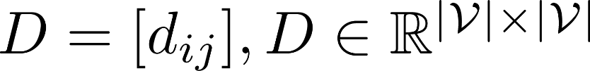
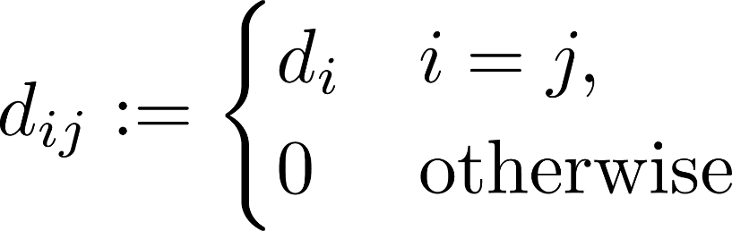
Degree matrix
1
2
3
4
5
6
7
Digraph: how a vertex (agent) influences others
8
9
EE185523 2022E – 1

Slide 10
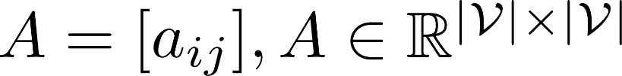
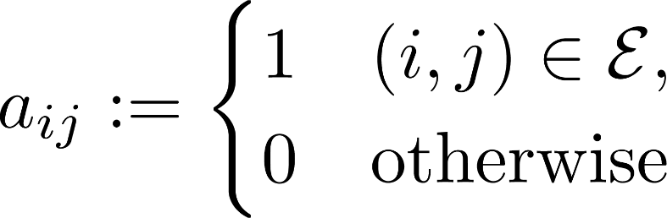
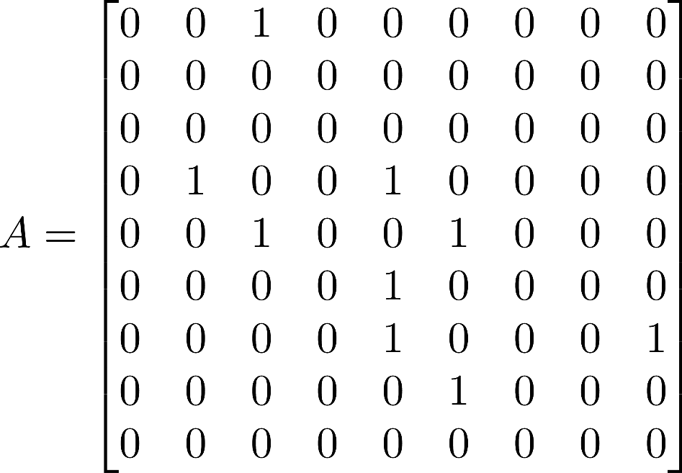
Adjacency matrix
1
2
3
4
5
6
7
8
9
EE185523 2022E – 1

Slide 11
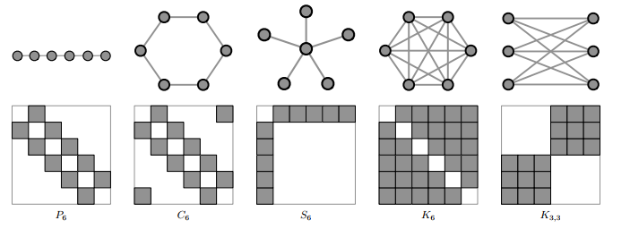
Adjacency matrix
EE185523 2022E – 1

Slide 12


Laplacian matrix
(undirected)
1
2
(directed)
3
4
Properties:
5
row-sums are zero,
non-diagonal entries are non-positive,
diagonal entries are non-negative.
6
7
8
9
Applications?
EE185523 2022E – 1

Slide 13



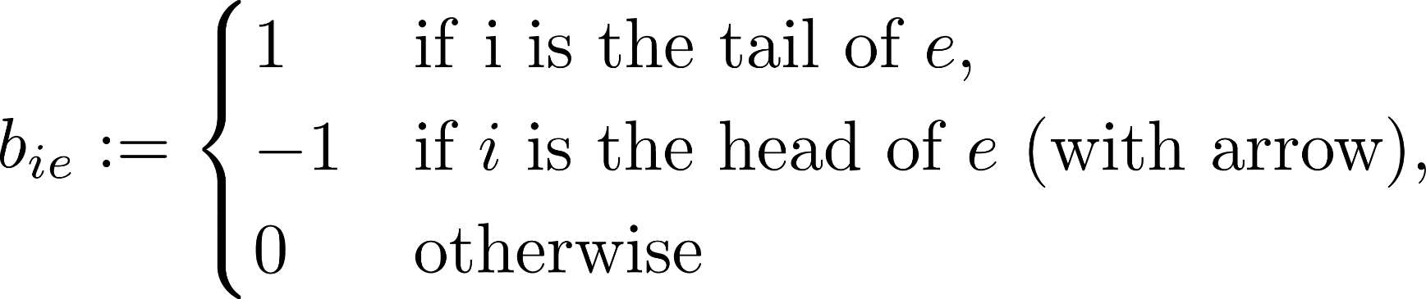
Incidence matrix
1
2
3
4
5
6
7
edges have to be labeled independently
8
9
EE185523 2022E – 1

